Slide 1
Interpretable ML
Christiano Rossini M. Costa

Slide 2

Why Intepretability?
High regulated market: medicine and others
Comply with GDPR (General Data Protection Regulation)
Improve models: it could dismiss useless features
Fairness: datasets is fullfilled with biased data around the world
And so on...

Slide 3
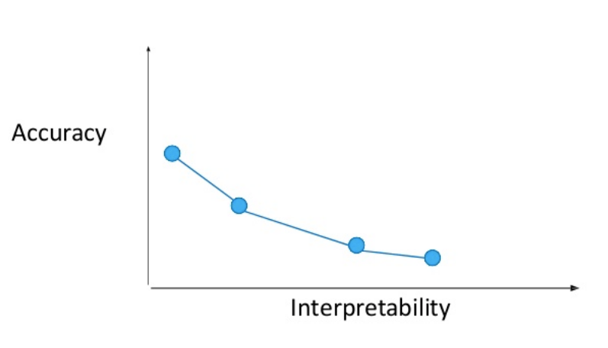
Accuracy x Intepretability trade-off
Source:https://www.slideshare.net/0xdata/interpretable-machine-learning-using-lime-framework-kasia-kulma-phd-data-scientist

Slide 4
Criteria for Interpretability Methods (MOLNAR, 2014)
Intrinsic or post hoc
By outcome
Feature summary statistic – how ech feature affects de model predictions
Feature summary visualization
Model internals
Weights – linear models
Learned tree structure – decision trees
Data point - ??
Intrinsically interpretable model - approximate black box (either globally or locally) with an interpretable model
Model-specific or model-agnostic
Local ou global

Slide 5
Scope of Interpretability (MOLNAR, 2014)
Global, Holistic Model Interpretability
How does the trained model make predictions?
Global Model Interpretability on a Modular Level
How do parts of the model influence predictions?
Local Interpretability for a Single Prediction
Why did the model make a specific decision for an instance?
Locally it might depend only linearly or monotonic
local distribution of the target variable might behave more nicely
Local Interpretability for a Group of Prediction
Why did the model make specific decisions for a group of instances?

Slide 6
Evaluating Interpretability (MOLNAR, 2014)
it’s not clear how to measure interpretability
No real consensus what is Interpretability on ML
Aproaches for evaluating Interpretability quality
Application level evaluation (real task)
Requires experimental setup
For specialists
Human level evaluation (simple task)
simplified application level evaluation
Without domain experts, but with lay humans
Function level evaluation (proxy task)
Does not require any humans
The model was already evaluated by someone in a human level evaluation
The proxy adjust the model for explanation quality

Slide 7
Evaluating Interpretability (MOLNAR, 2014)
More dimensions to intepretability
Monotonicity
Is there a monotonicity constraint?
Interations
Is the explanation able to include interactions of features?
Cognitive processing
How long does it take to understand the explanation?
Feature complexity
What features were used for the explanation?
Description length of explanation.

Slide 8
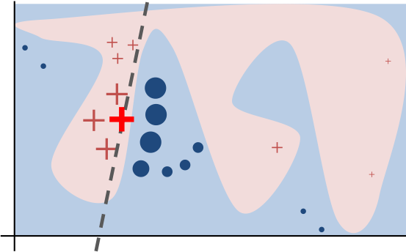
Model-Agnostic Methods
Partial Dependence Plot (PDP)
Individual Conditional Expectation (ICE)
Feature Interaction
Feature Importance
Global Surrogate Models
Local Surrogate Models (LIME)
Shapley

Slide 9
References
https://christophm.github.io/interpretable-ml-book/criteria-for-interpretability-methods.html

Slide 10
Applied Model agnostic interpretability on Software Engineering: an approach under developer perspective

Slide 11
Motivation
New Machine learning specific area
Interpretability is a
Lack of study of how interpretable a prediction are from a deployed model, through user’s eyes.
???
???

Slide 12
Objectives
Build white box models from a dataset and explore their interpretability and accuracy
Build black box models from same dataset and explore their interpretability, through model-agnostic models, and accuracy
Compare effectiveness of both interpretable models considering:
How interpretable it is alongside survey

Slide 13
Subject

Slide 14
Questions

Slide 15
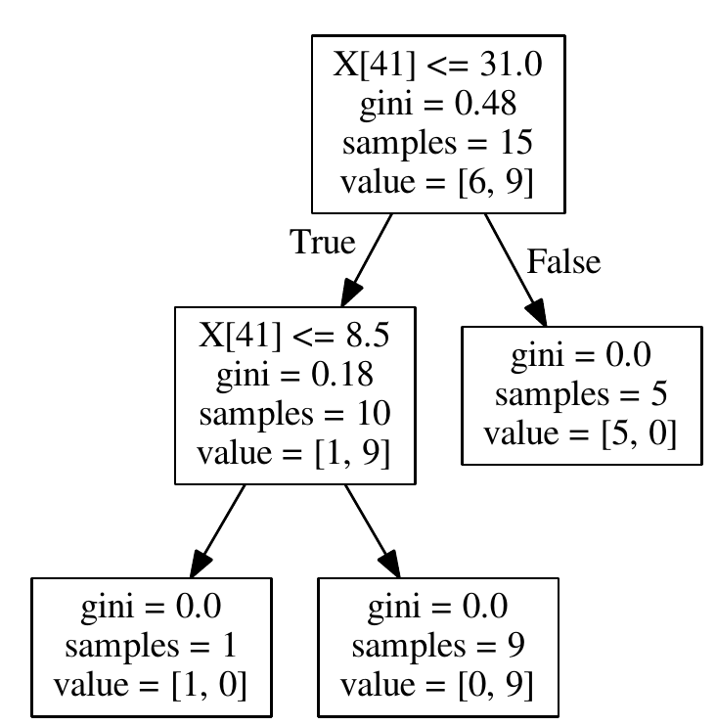
Learning With Decision Tree
DecisionTreeClassifier(class_weight=None, criterion='gini', max_depth=None,
max_features=None, max_leaf_nodes=None,
min_impurity_decrease=0.0, min_impurity_split=None,
min_samples_leaf=1, min_samples_split=2,
min_weight_fraction_leaf=0.0, presort=False, random_state=None,
splitter='best')

